Slide 1
SQI Pipeline Walkthrough
Stage by stage: what the code does, and why — as discussed with Mark & Rutendo
Lab Meeting Update — Lupita

Slide 2
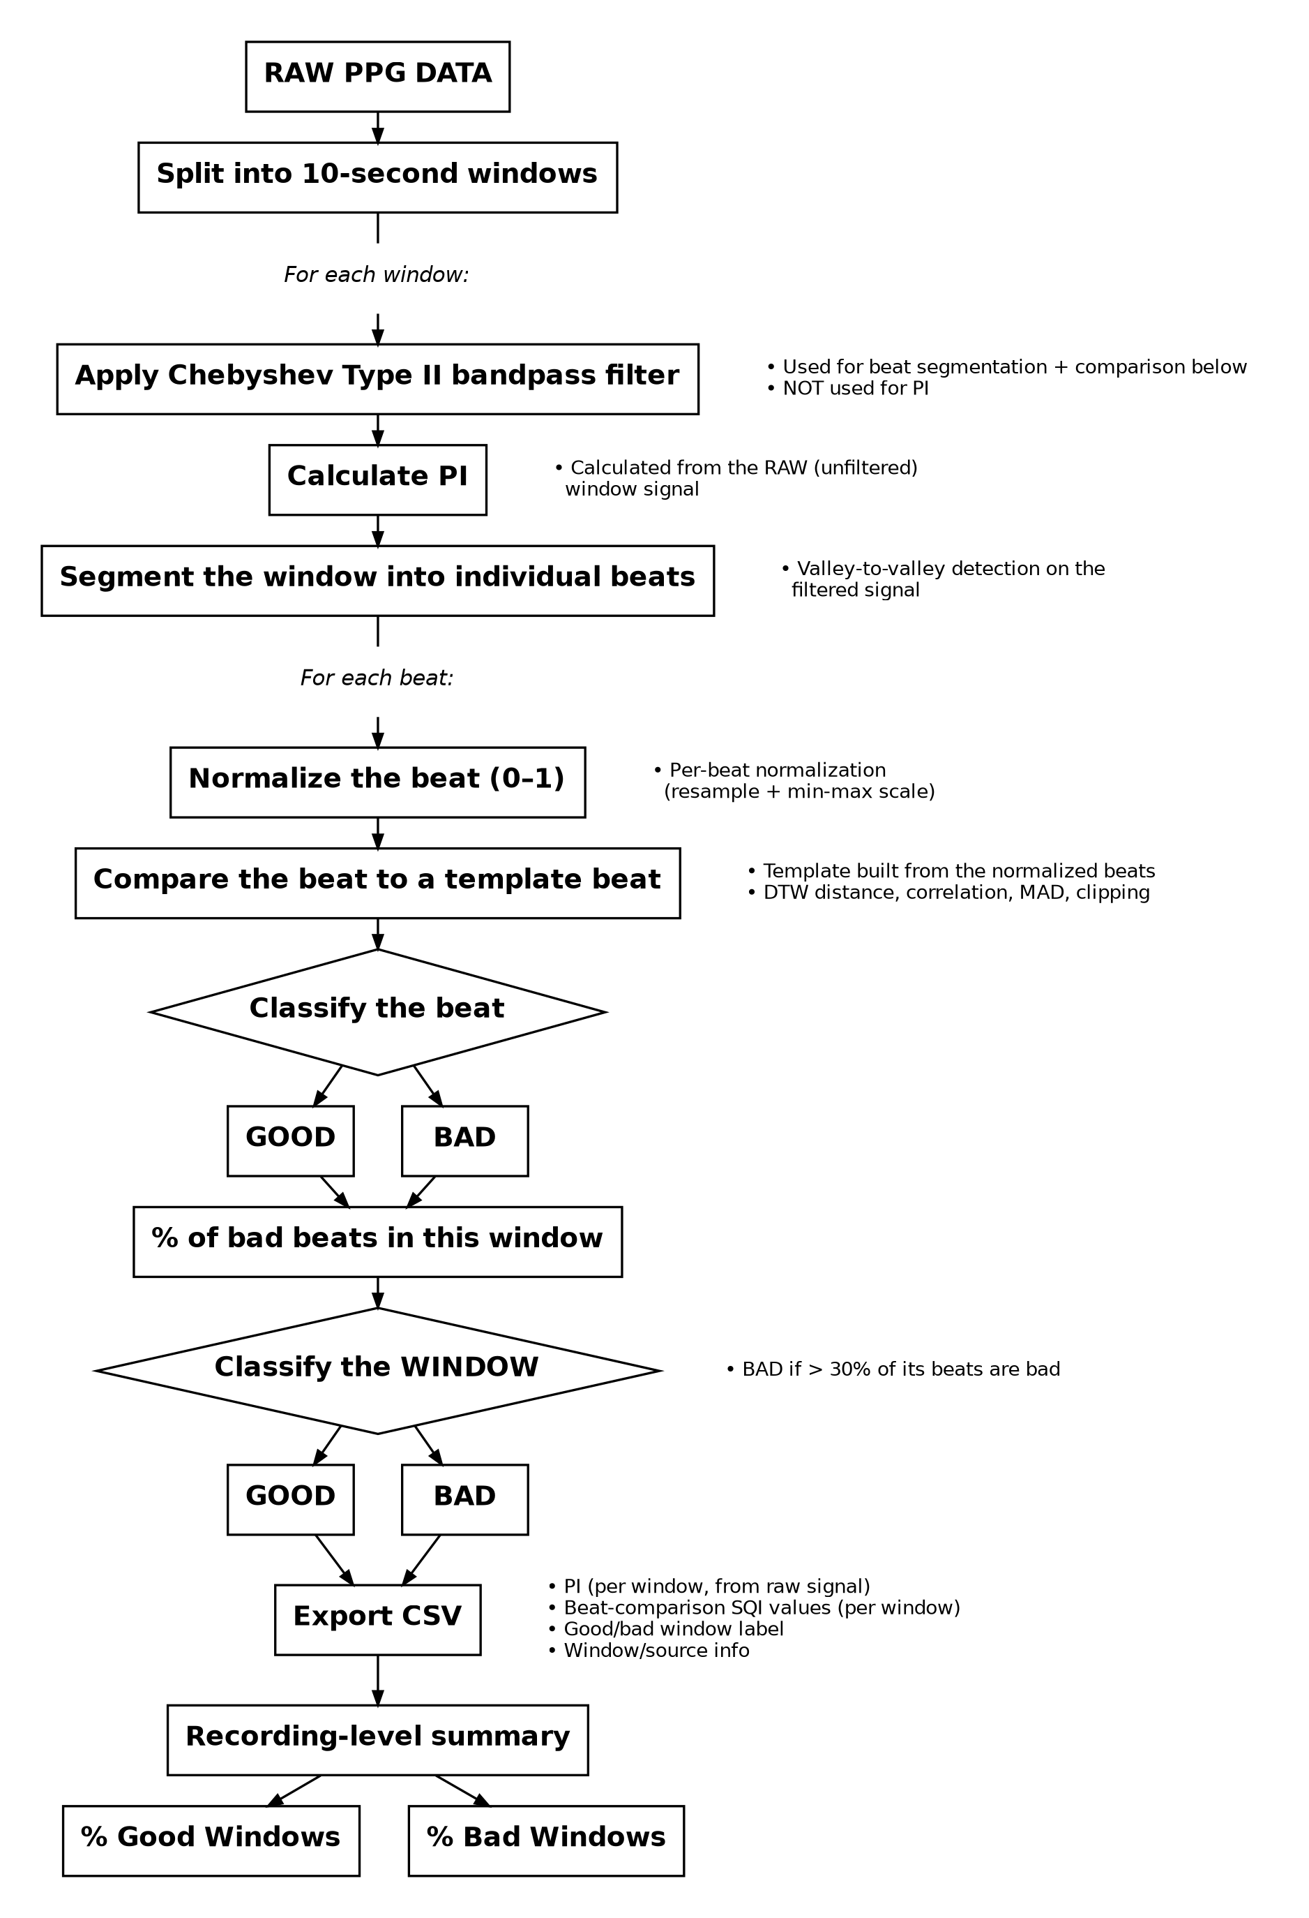
The Approved Pipeline
Signed off by Mark — full detail on the following slides

Slide 3
STEP 1
Split Into Windows
Raw PPG signal gets chopped into 10-second windows, and everything downstream — filtering, PI, beat segmentation, classification — runs independently on each window.
This is the loop run_sqi_over_windows() drives, using iter_windows() to slice things up.
</>
Code snippet
e.g. iter_windows() / run_sqi_over_windows()

Slide 4
STEP 2
Bandpass Filter
Each window runs through a Chebyshev Type II bandpass filter — bandpass_filter() inside preprocess_ppg().
This filtered version is what we use for beat segmentation and beat-to-beat comparison later on. It's NOT used for PI — filtering strips out the DC baseline that PI actually needs.
</>
Code snippet
e.g. bandpass_filter() / preprocess_ppg()

Slide 5
STEP 3
Calculate PI
PI is calculated in compute_perfusion_index(), straight off the RAW, unfiltered window — not the filtered one.
This was one of the two big fixes after our last round of feedback: PI was blowing up to hundreds/thousands of percent when computed on the filtered signal, since the filter removes the DC component that AC/DC needs to mean anything.
</>
Code snippet
e.g. compute_perfusion_index()

Slide 6
STEP 4
Segment Into Beats
segment_beats_by_valleys() finds individual beats by doing valley-to-valley detection on the filtered signal.
This is where we went back to real beat-by-beat comparison after Mark pointed out we still needed it, instead of judging the whole window at once.
</>
Code snippet
e.g. segment_beats_by_valleys()

Slide 7
STEP 5
Normalize Each Beat
Every individual beat gets normalized on its own — resampled to a fixed length and min-max scaled to 0–1 — in normalize_single_beat().
This is the per-beat normalization Mark meant. We'd originally built it as per-window, which he clarified wasn't what he had in mind.
</>
Code snippet
e.g. normalize_single_beat() / normalize_beats()

Slide 8
STEP 6
Compare to a Template Beat
A clean template gets built from the normalized beats — make_clean_template().
Each beat gets compared against that template in compute_beat_features(): DTW distance, correlation, MAD, and clipping all get computed here.
</>
Code snippet
e.g. make_clean_template() / compute_beat_features()

Slide 9
STEP 7
Classify Beat, Then Window
classify_beat() labels each beat good/bad off those comparison metrics.
run_beat_comparison() rolls that up into a percent-bad-beats number for the window, and the window gets marked bad if more than 30% of its beats are bad.
</>
Code snippet
e.g. classify_beat() / run_beat_comparison()

Slide 10
STEP 8
Export CSV
run_window_level_sqi() and run_sqi_over_windows() write one row per window to CSV.
Each row has: PI (from the raw signal), the beat-comparison SQI values, the good/bad window label, and window/source info.
</>
Code snippet
e.g. run_window_level_sqi() / run_sqi_over_windows()

Slide 11
STEP 9
Recording-Level Summary
Each recording's process_*() function rolls all of that recording's windows up into %good / %bad windows.
process_experiment1_complete(), process_day3_experiment2(), and process_day4_experiments() each do this for their respective data.
</>
Code snippet
e.g. process_experiment1_complete() (or the Day 3/4 equivalents)

Slide 12
Results on Real Data
Implemented and running across Day 2 / 3 / 4 recordings.
</>
33.12%
Good Windows
66.88%
Bad Windows
Code snippet
e.g. terminal output / summary CSV screenshot
Fully reproducible — reran it and got the exact same split, so the pipeline itself is deterministic (nothing random going on).

Slide 13
Open Questions for Mark & Rutendo
Is the Unpolarized_A_Green (C5) PI issue a hardware/sensor thing we should exclude or flag, or is there a processing fix worth trying?
clipping_sqi values cluster tightly (roughly 0.55–0.94, median around 0.82) right around our 0.80 cutoff, for both good and bad beats. Worth rethinking whether the threshold or the underlying clipping formula needs adjusting?

